Slide 1
Phase 1 therapy

Slide 2
Rationale –microbial etiology

Slide 3
Homeostatic mechanisms
Caries
Acidogenic/aciduric:
- Mutans streptococci
- Lactobacilli
- Other acidogenic/
aciduric streptococci
Periodontal diseases
Gram-negative anaerobes:
- Spirochaetes
(e.g. Treponema denticola)
- Porphyromonas gingivalis
- Tannerella forsythia
- Aggregatibacter
actinomycetemcomitans
Health
Plaque community
stability
Frequent sugar/
low pH challenges
Low saliva flow
Inflammation/
increased gingival crevicular fluid flow
Immune suppression
Ecological perturbation

Slide 4
Ecological Plaque Hypothesis
Gingival Health
Gingival Health
Reduced Plaque
Low GCF
Reduced inflamn
G+ve bacteria
Environmental change
Ecological shift
Stress
Increased inflamn
High GCF,temp&pH,BOP,lowEh
G-ve anaerobes
Increased Plaque
Gingivitis
Gingivitis

Slide 5
Sequence of procedures
Plaque control instructions
Removal of supragingival and subgingival calculus
Recontouring defective restorations and crowns
Management of carious lesions
Antimicrobial therapy
Occlusal therapy
Minor orthodontic therapy
Provisional splinting and prosthesis
Tissue reevaluation

Slide 6
Results
Quadrant wise SRP
Full mouth SRP
Full mouth disinfection (Marc Quirynen)

Slide 7
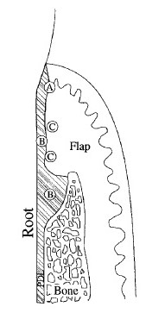
Healing
Type - Long junctional epithelium
Stages of healing
Inflammatory
Granulation tissue formation
Maturation

Slide 8
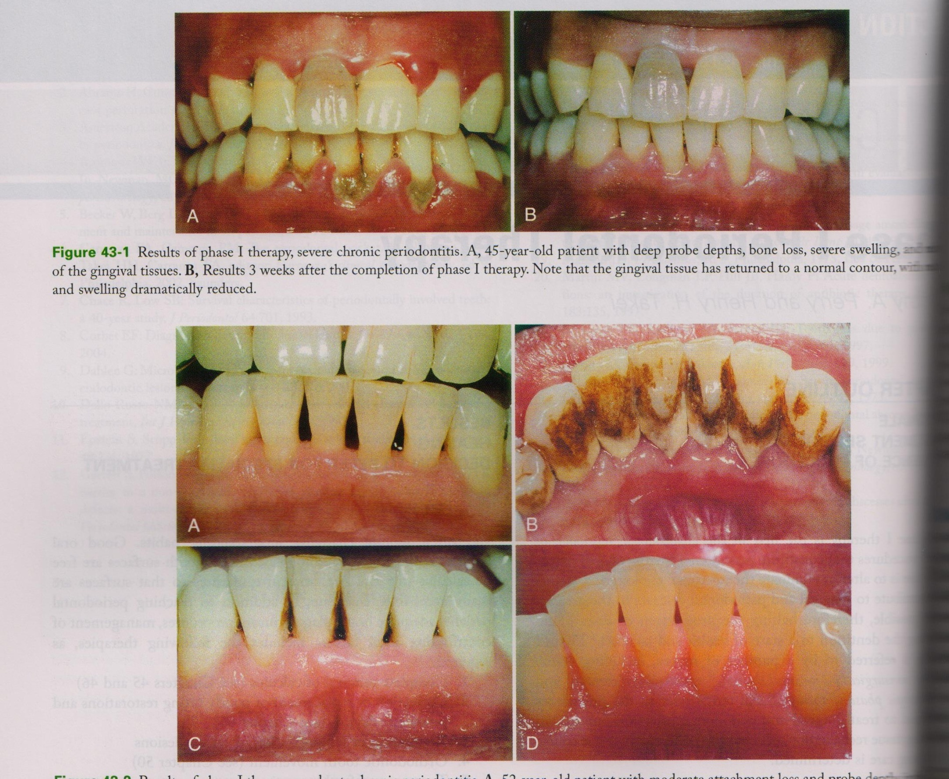
Sequelae
Recession
Transient root sensitivity

Slide 9
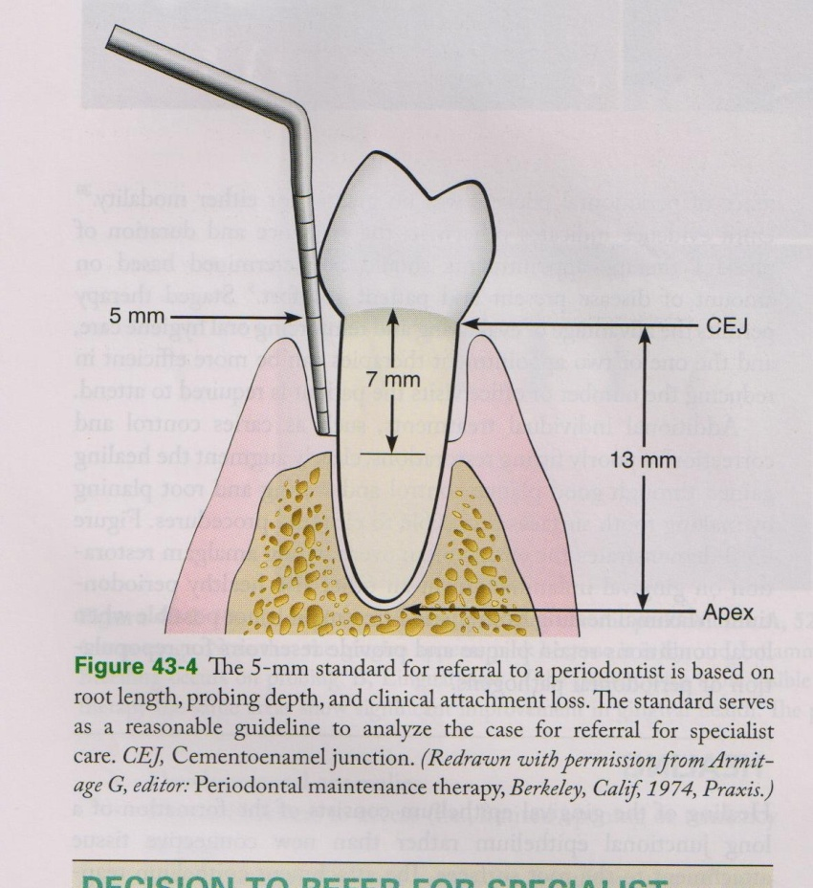
Decision to refer
Extent of disease
Root length
Hypermobility
Difficulty of SRP
Abutments
Age of pt
Lack of resolution of inflammation

